Slide 1
Model Railroading
3D Printing
Presented by Jim Tatum
IVD MEet
January 2019

Slide 2
What is 3D printing?
3D printing refers to a number of different technologies for creating objects using “additive” manufacturing processes
An “additive” manufacturing process builds an object by combining many thin layers of material
Developed in the early 1980s for rapid prototyping in manufacturing
Technology has rapidly developed and is now being tested out in many other fields:
• Aerospace - Rocket and jet engines
• Medical / Biotech - Prosthetics, hearing aids, organs?
• Fashion - Jewelry, eyewear

Slide 3
What is 3D Printing?
Main types of 3D printing:
  SLS - Selective laser sintering (melt powder together with a laser)
  SLA - Stereolithography (use UV light to cure plastic resin)
  FDM - Fused deposition modeling (melt plastic and extrude it)

Slide 4
What is 3D Printing?
Materials used in 3D printing, called filament
  Plastic - Acrylic, vinyl, ABS, PLA, PETG
  Metal - Steel, gold, silver, …
  Carbon based PLA

Slide 5
3D Printed Model Trains?
Why use 3D printing for model trains?
  Create unique models that can be shared with others
  Easy to make variations of models using copy and paste
  Easy to make duplicates for building fleets of cars or replacing broken models

Slide 6
What kind of things can you make?
Scenery Details
Animals
Figures
Small Buildings
Vehicles
And more…

Slide 7
Design file needs to be converted to gcode
Starts with a STL or AutoCAD file
  File is places in a slicing program such as….
    Cura (free)
    Slic3r (free)
    Repetier (free)
    Simply3d (paid program)
  The slicing program then slices the design file into layers and creates a new file that the 3d printing firmware can read called a gcode file.

Slide 8
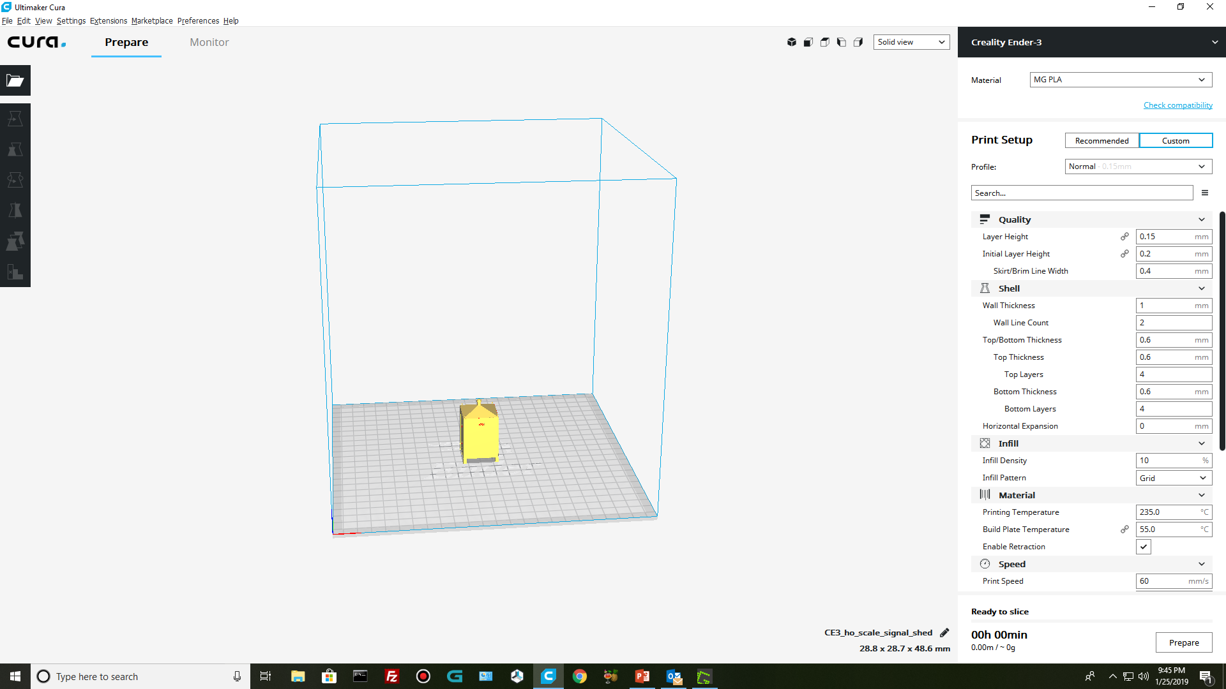

Slide 9
How does 3D printing work?
The 3D printing process works by melting plastic filament which is deposited a layer at a time through a heated extruder onto a movable build platform.
Each layer hardens as it is deposited and bonds to the previous layer.

Slide 10
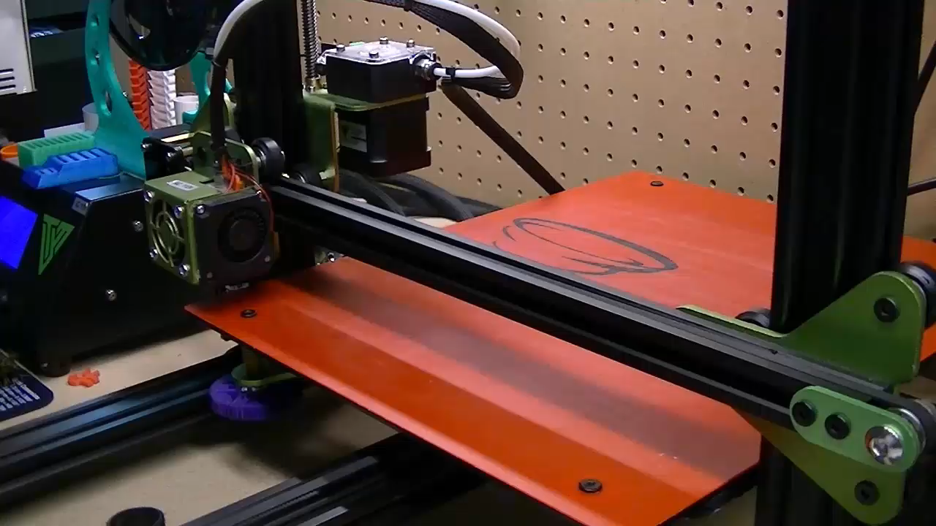
How does 3D printing work?

Slide 11
3D Printer
  You can download design files off the internet from several websites and there are several thousand STL files available to download at no cost.
  Don’t need to know how to use AutoCAD programs. Someone as already done the work for you.
  But this doesn’t mean there is a file for everything you want to print.
  Places to find STL design files on the internet
    Thingiverse.com, stlfinder.com, cults3d.com and many more.

Slide 12
3D Printer advantages
  Money savings
    You can print your own buildings, scenery accessories, trucks and even loco shells
    Cost of filament is cheap. $18-35 for a 2KG spool
      2KG = 1000ft of filament.
    Replacement parts are inexpensive, nozzles, Bowden tubes, stepper motors, etc.

Slide 13
3D Printer Disadvantages
  Constantly leveling 3d printer bed (unless auto-level)
  Constantly tweaking slicer settings for optimal print results
  Each roll of filament is different even from the same manufacturer and same color. Temp towers are needed for each spool to obtain optimal hotend temperature settings.
  Once you have all these completed and printing perfectly, be prepared to start all over again after about 12 prints. These things go out of adjustment.

Slide 14
3D Printer
Online resellers
  Banggood.com – China
  Aliexpress.com – China
  Gearbest.com – China
  Amazon.com
  Makergeeks.com – US Filament Manufacturer in Springfield, MO
Chinese Vendors are 30-60% less than US Vendors, but shipping can take up to 2 weeks to deliver.

